Slide 1

Oct. 2022
GitHub tutorial for beginners
Zheng Liu
School of Humanities and Social science

Slide 2
Outline
What is GitHub?
Create and use a repository
Creating a repository on GitHub
The README file
Pull and push operation
Make local changes to a file and push them to GitHub as commits
gitignore operation
Fork a project repository
Clone your fork project to local path
Collaboration using GitHub
Bonus: Portfolio showcasing using GitHub

Slide 3


What is GitHub?
???

Slide 4
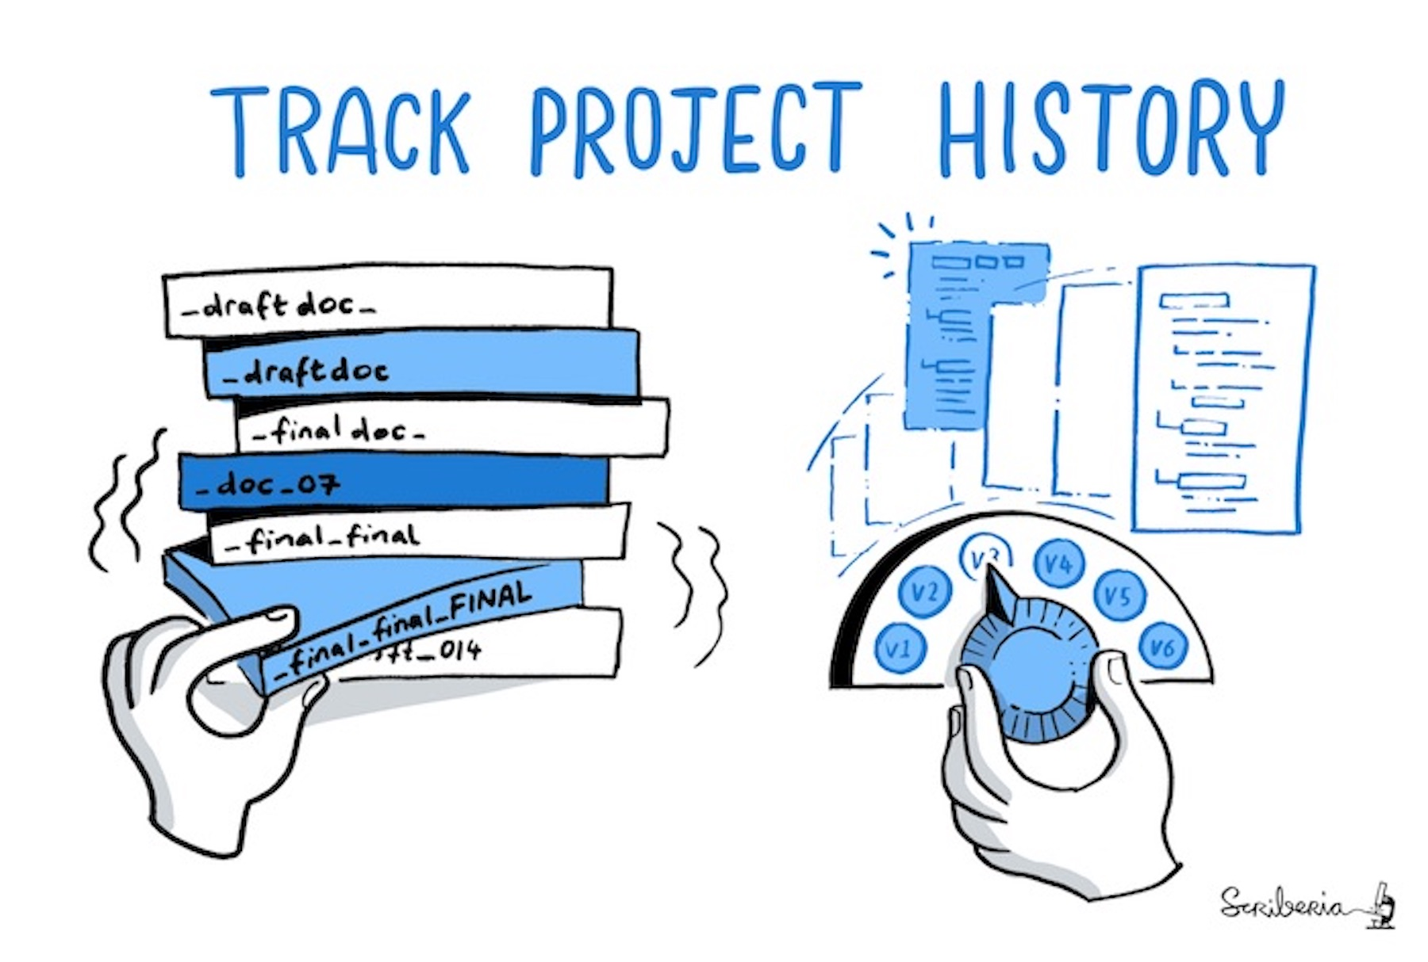
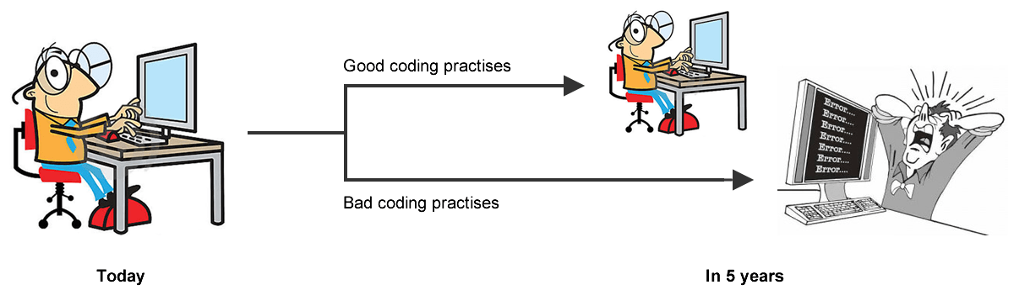

What is GitHub?
A code hosting platform for version control and collaboration.
What and why version control?
Version control helps you track and manage changes to a project’s code.

Slide 5
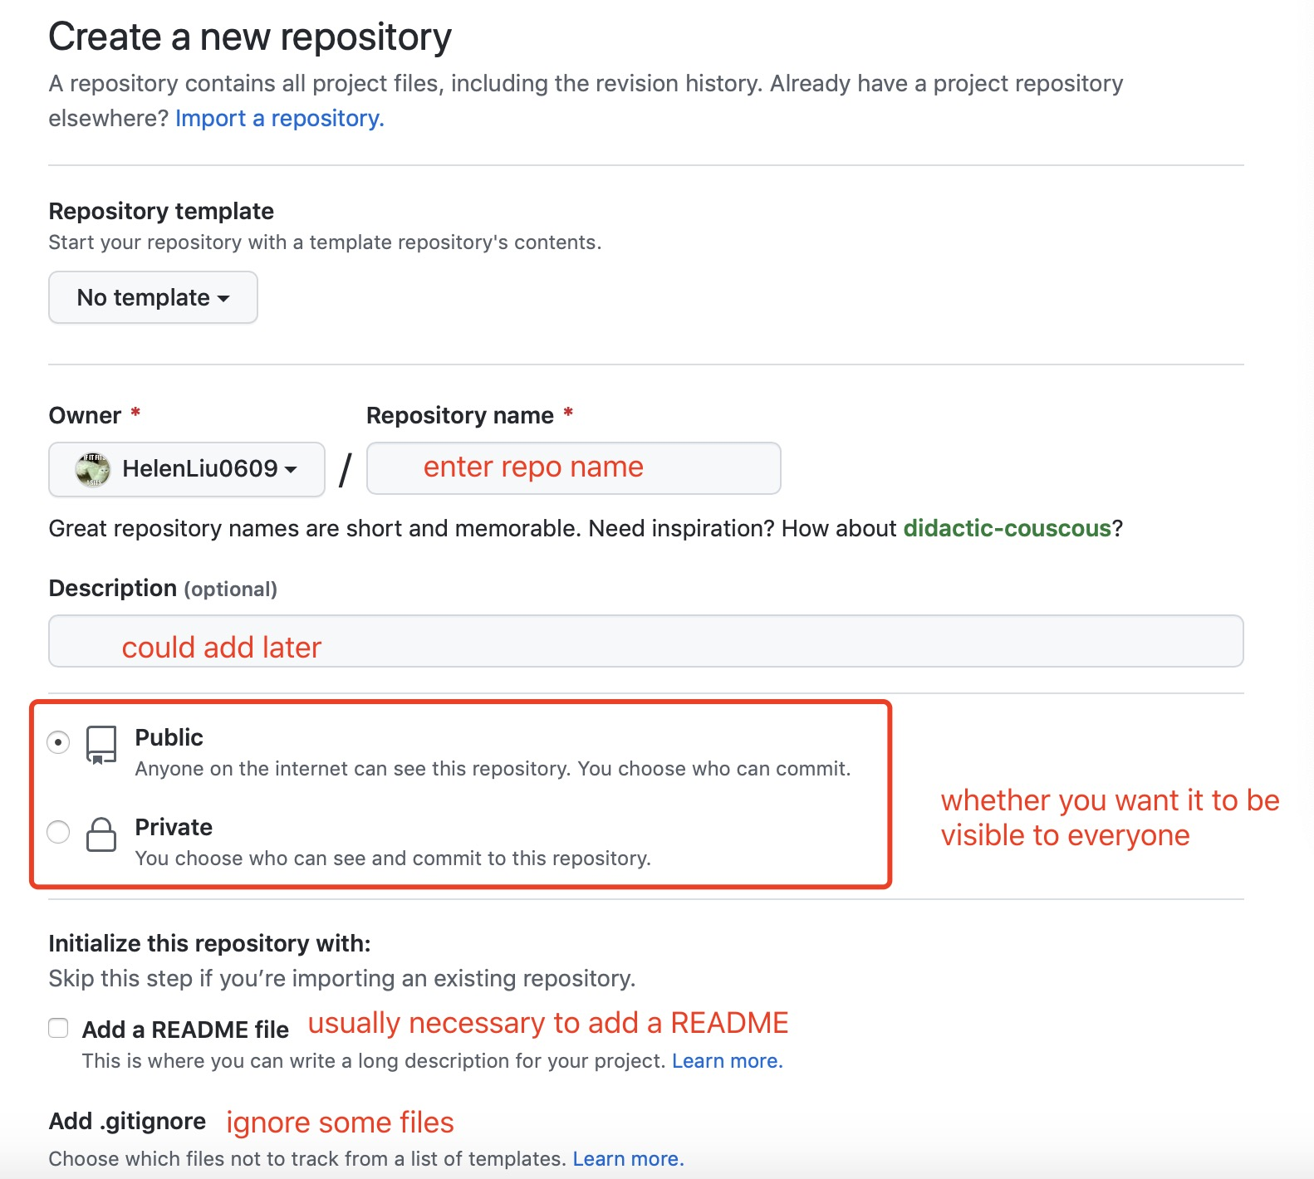

Creating a repository on GitHub
step 1
step 2

Slide 6
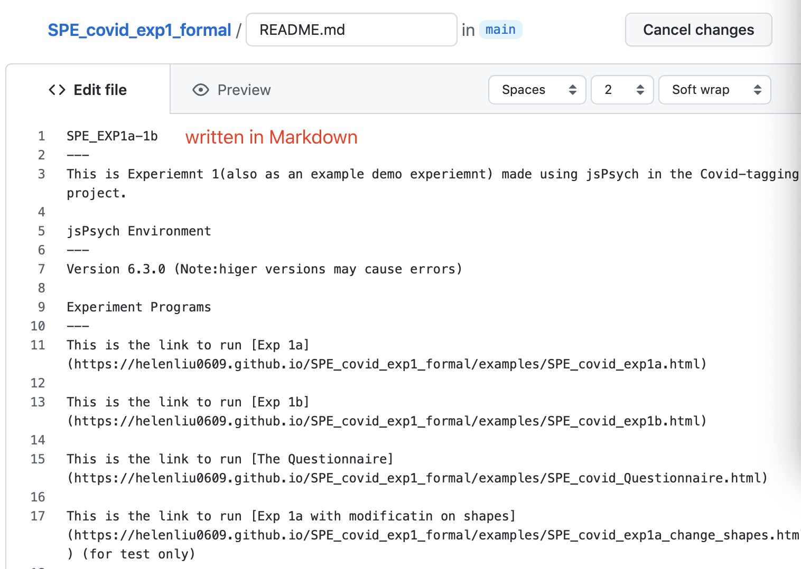
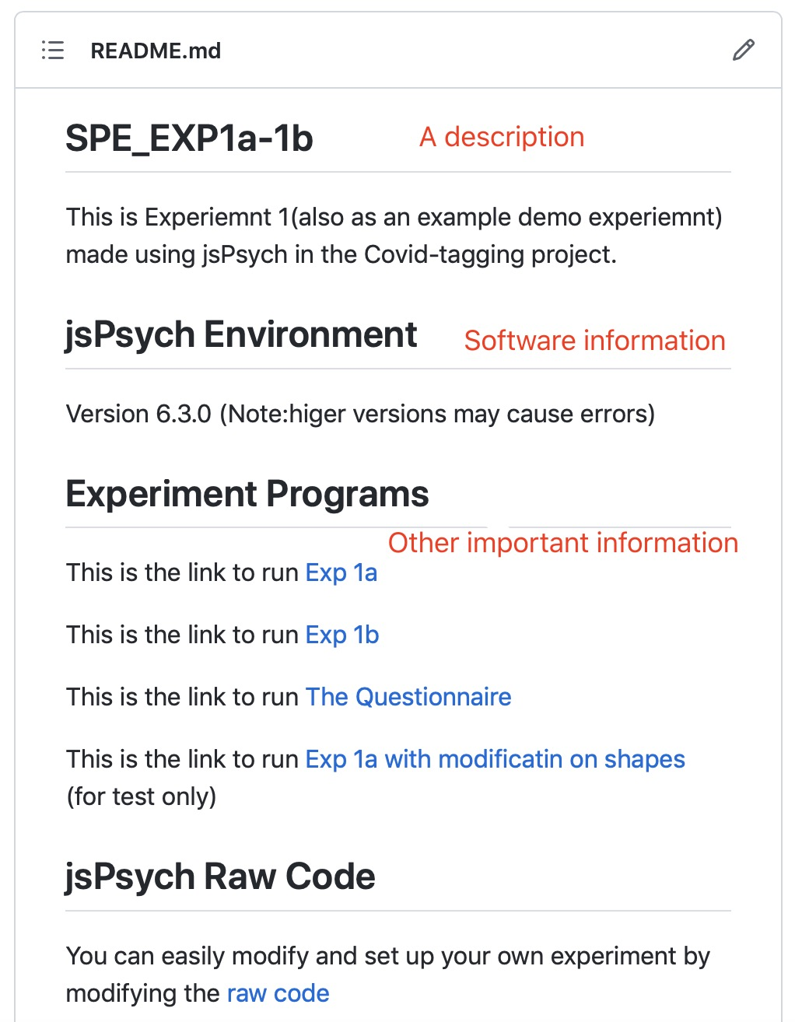
The README file
A README file is a text file that describes and launches a project. It comprises information that is frequently needed to grasp the scope of the project

Slide 7
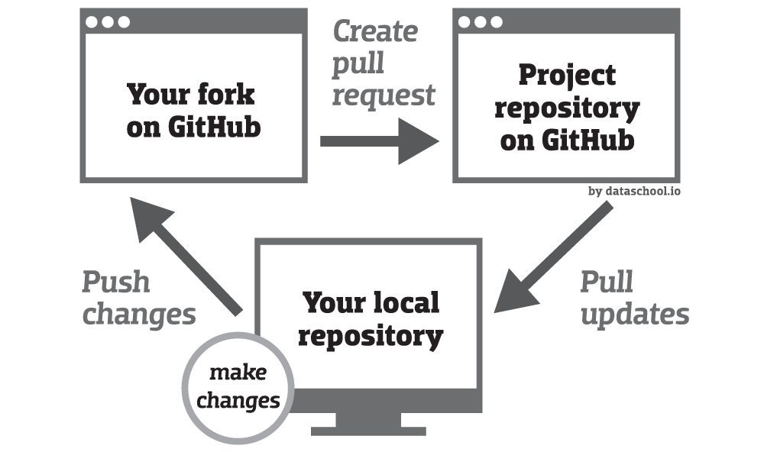

Pull & Push operation
GitHub Desktop brings better integration with your GitHub Pull Request.

Slide 8
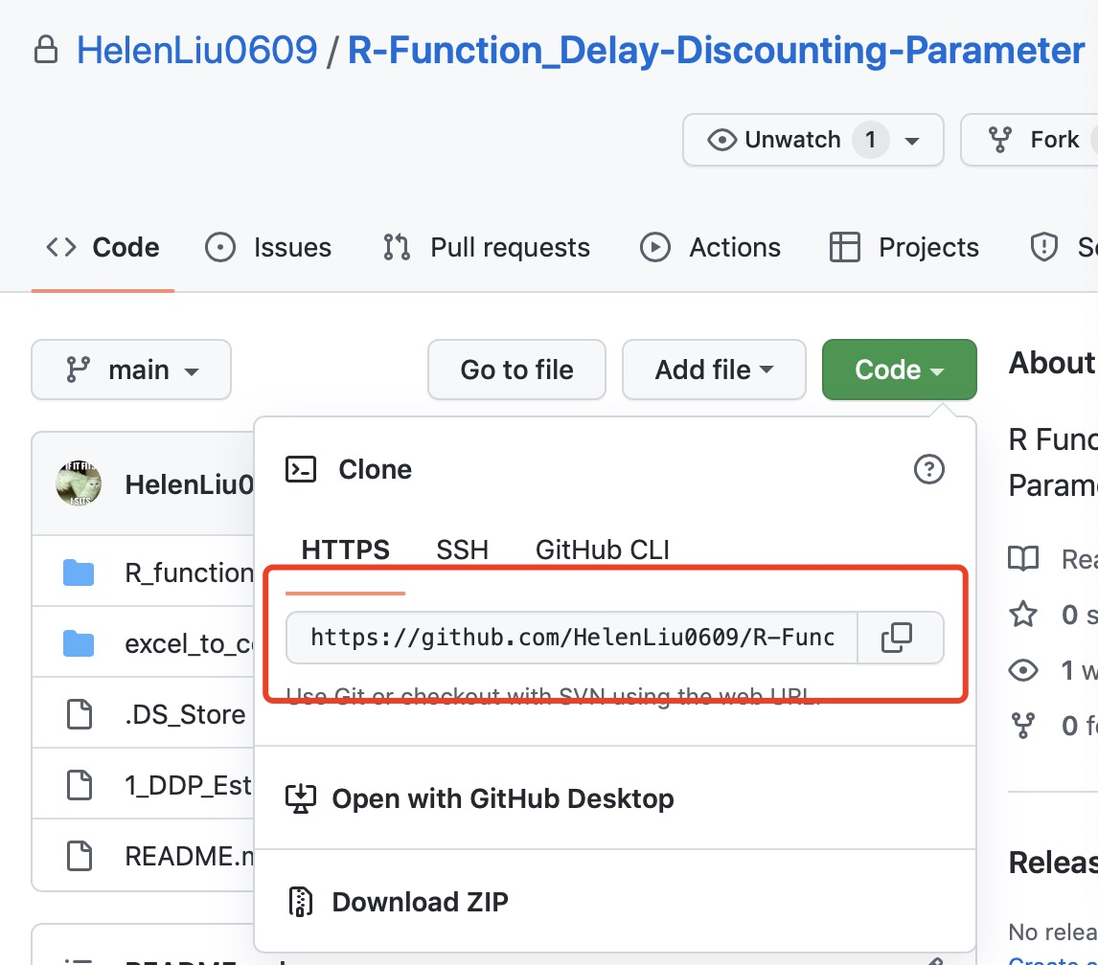
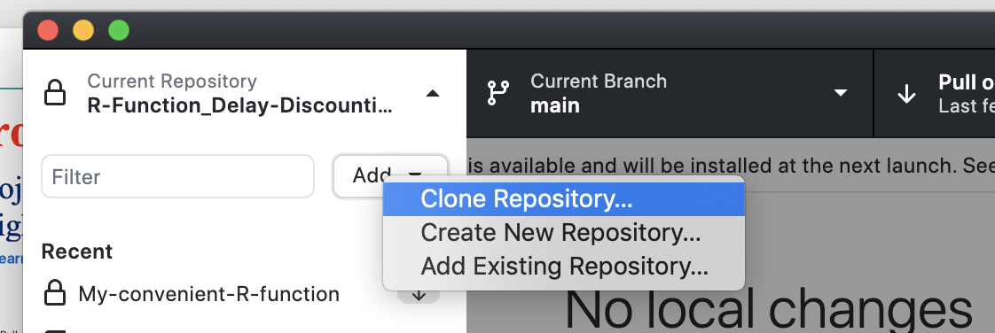
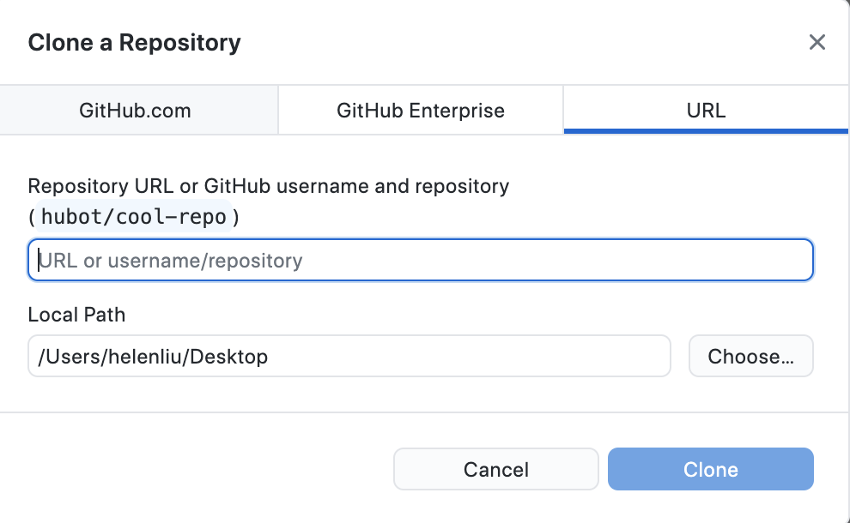
Clone your fork project to local path
step 1
step 2

Slide 9
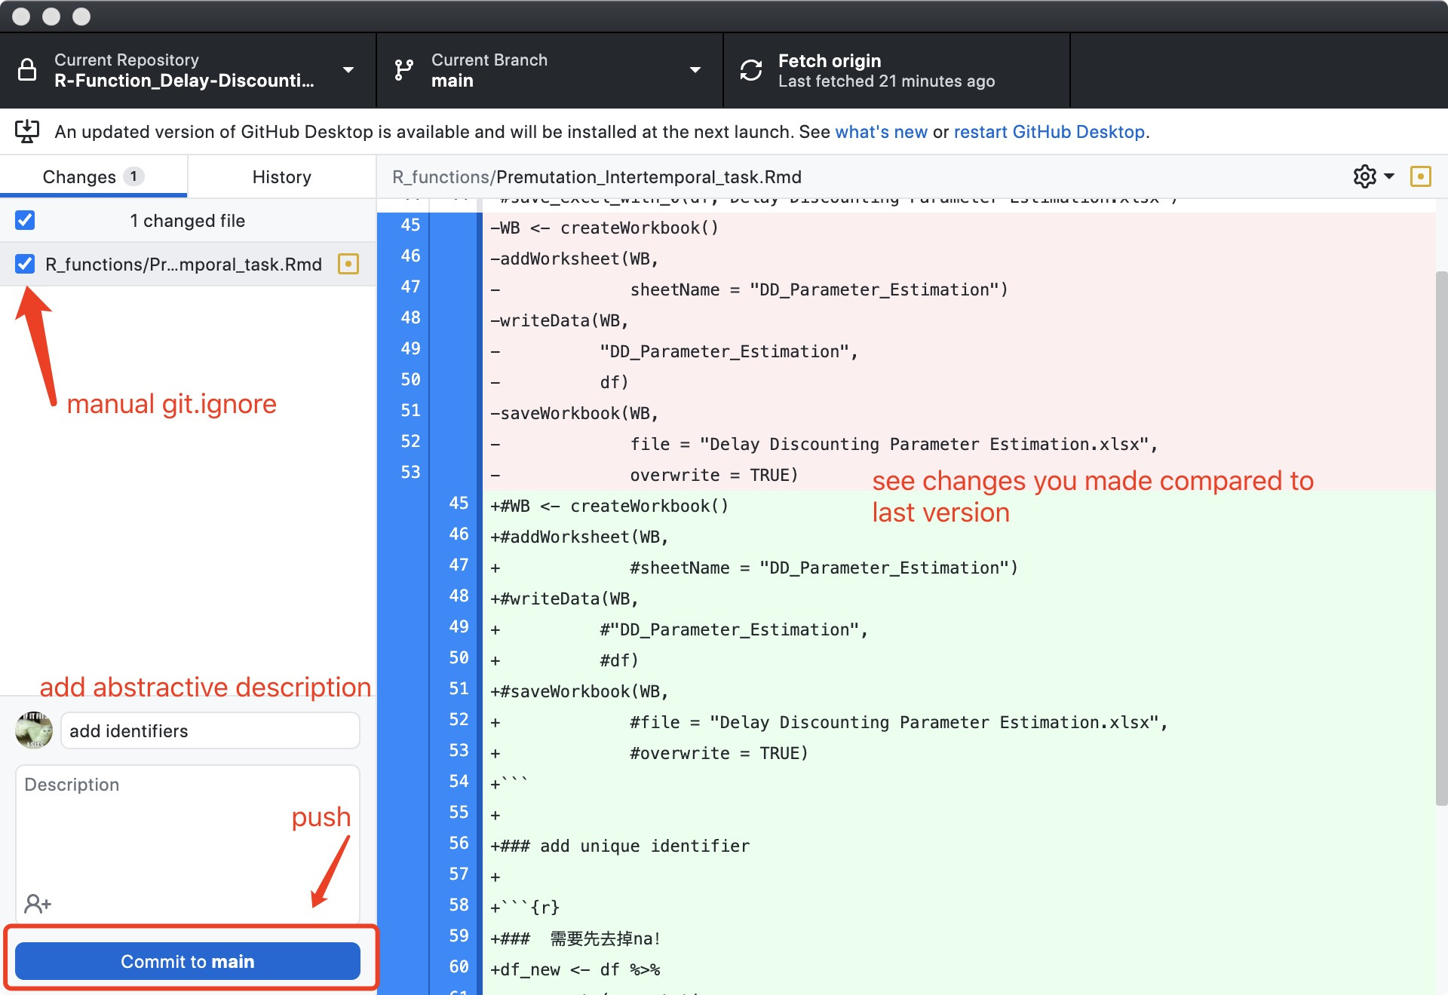
Commit your changes and push to GitHub

Slide 10
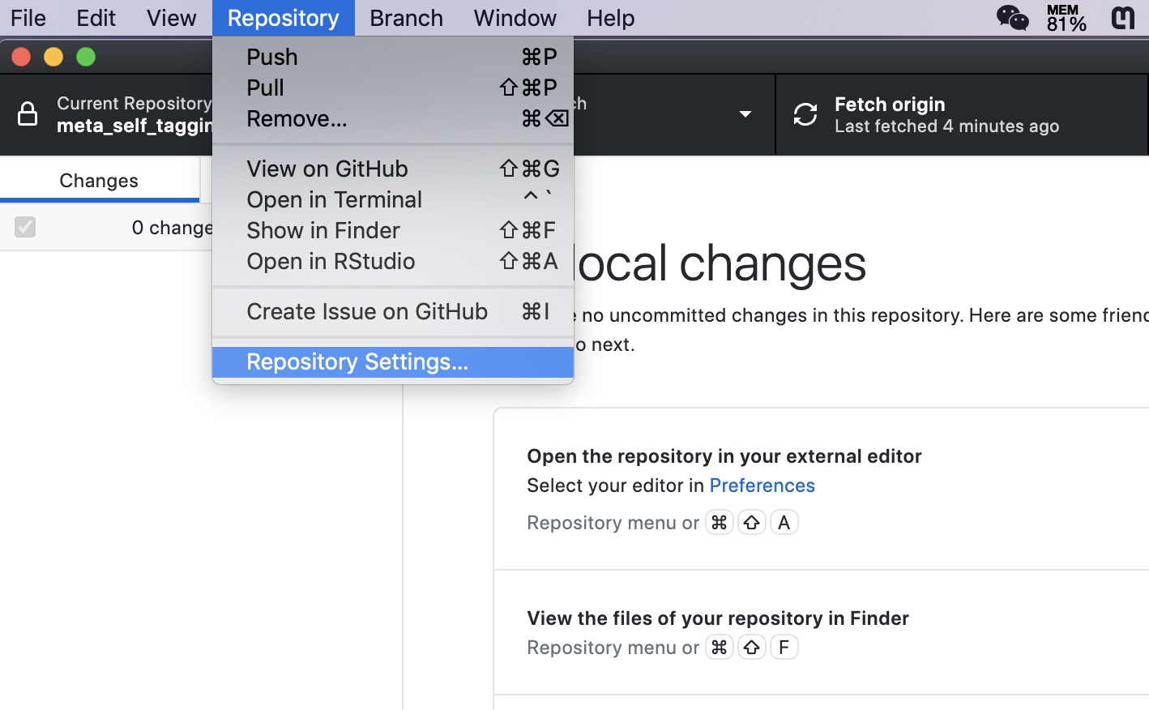

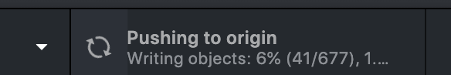
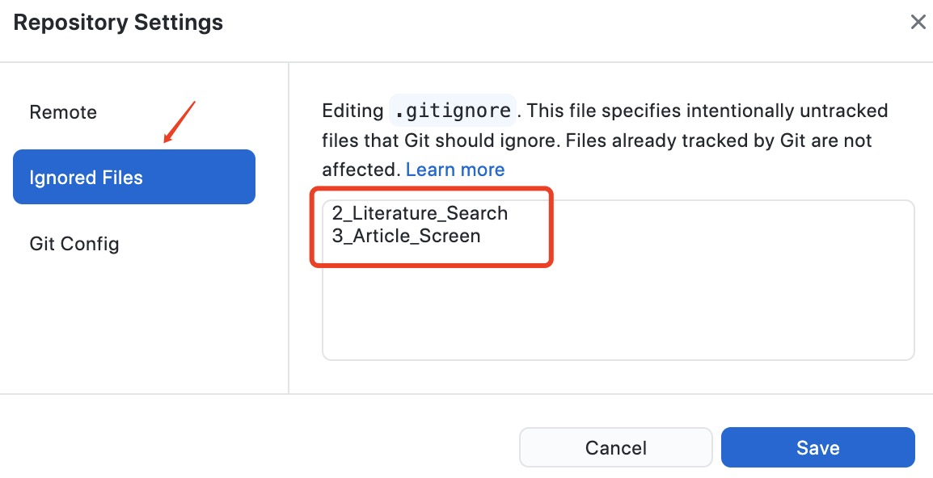
Gitignore operation
For more information: https://git-scm.com/book/en/v2/Git-Basics-Recording-Changes-to-the-Repository#_ignoring
Why gitignore?

Slide 11
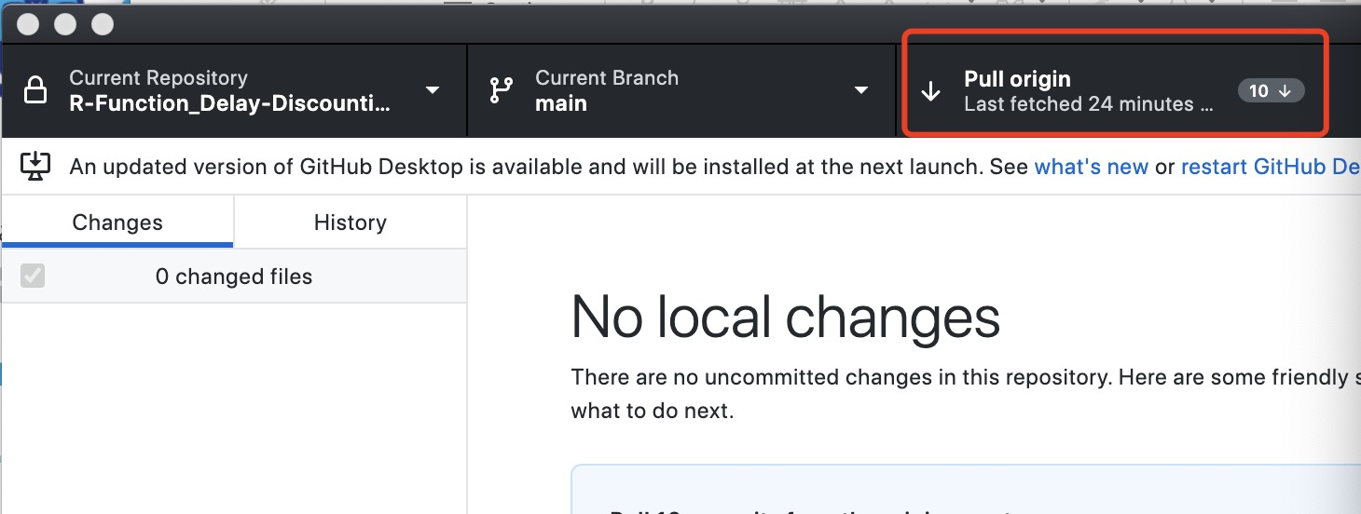
Pull the latest changes from upstream into your local repository

Slide 12
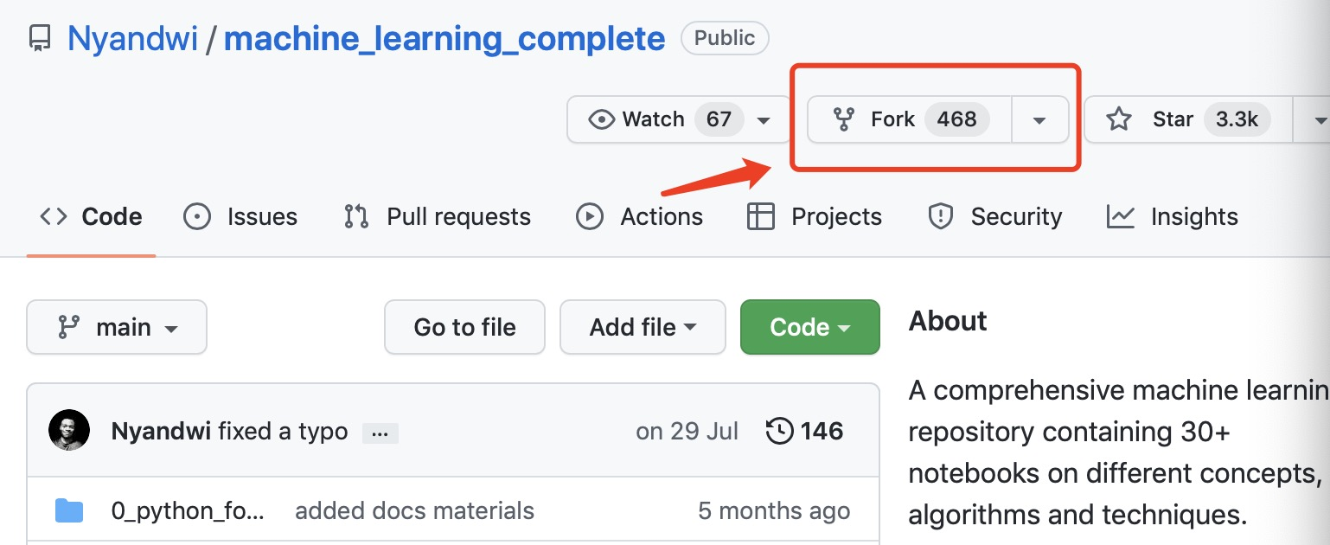
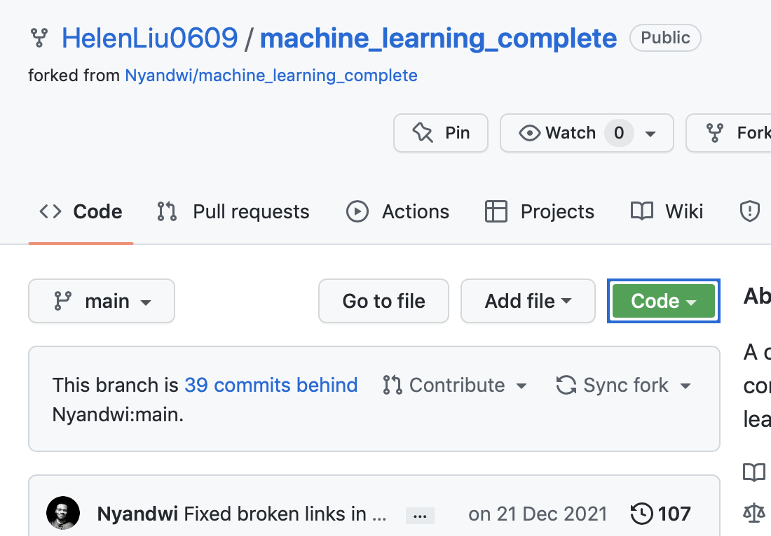
Fork a project repository
Find the project's repository on GitHub, and then "fork" it by clicking the Fork button in the upper right corner:

Slide 13
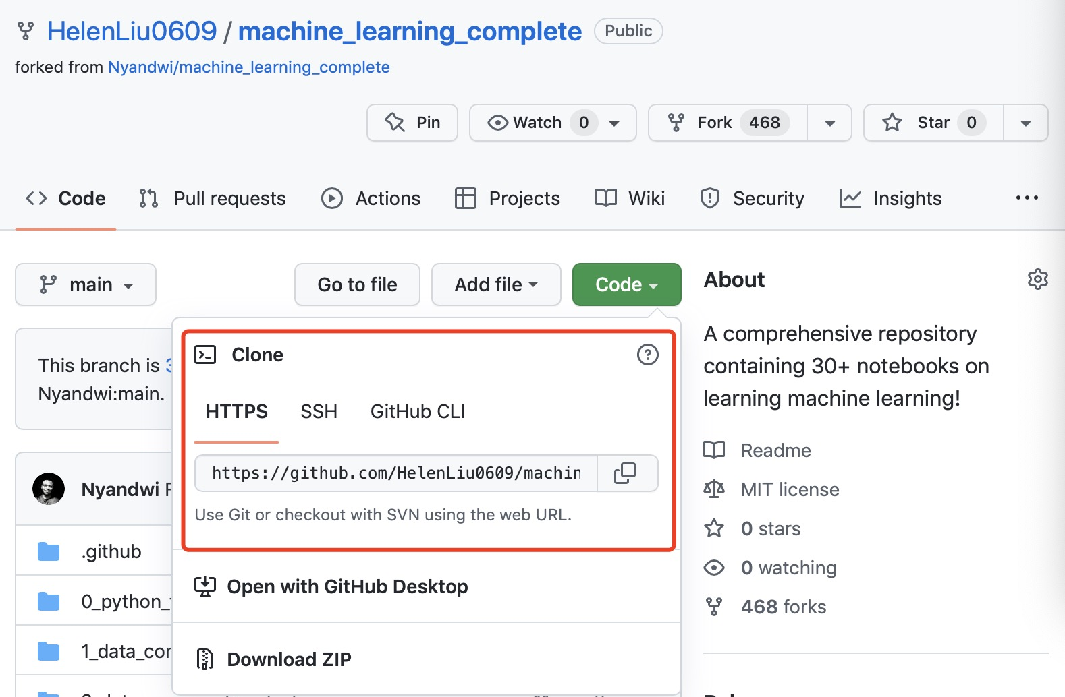
Clone your fork project to local path
step 1
step 2

Slide 14

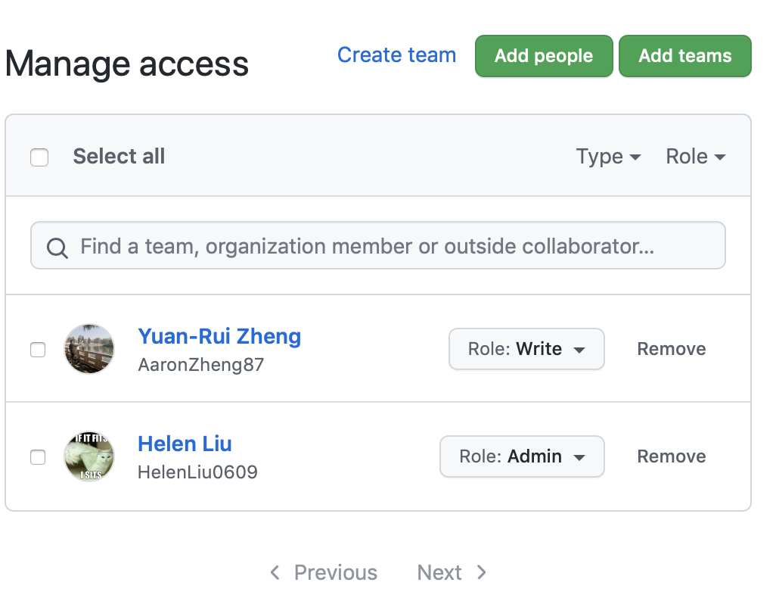
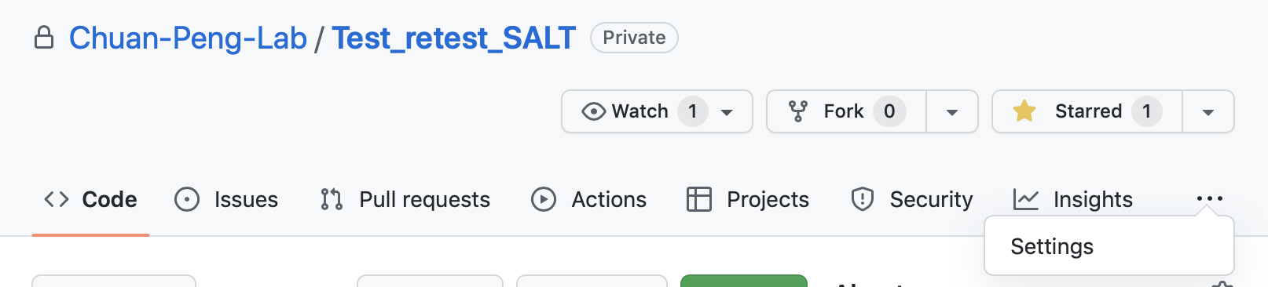
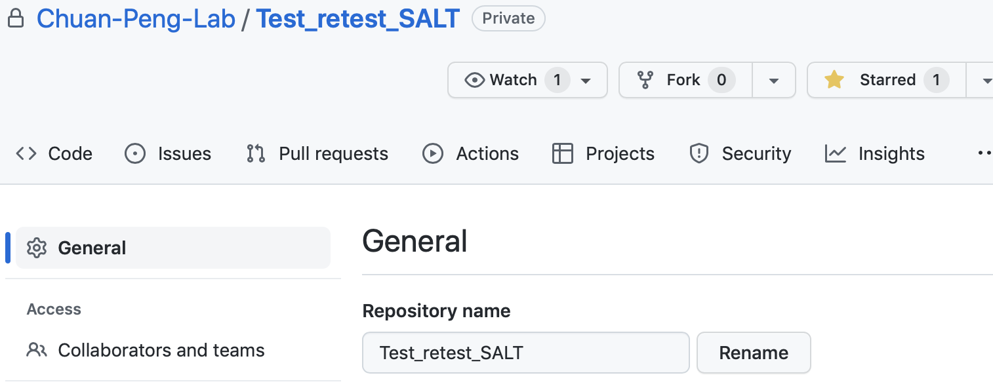
Collaboration
step 3
step 1
step 2

Slide 15

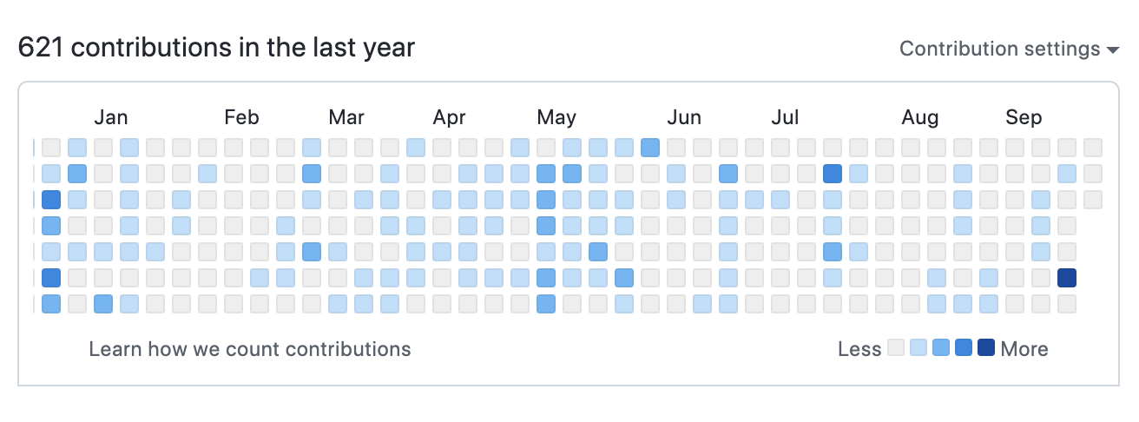
Portfolio showcasing: A GitHub account is a résumé
Self intro
Show your commitments

Slide 16
Thank you for listening

Slide 17
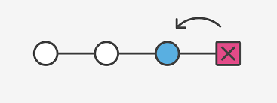
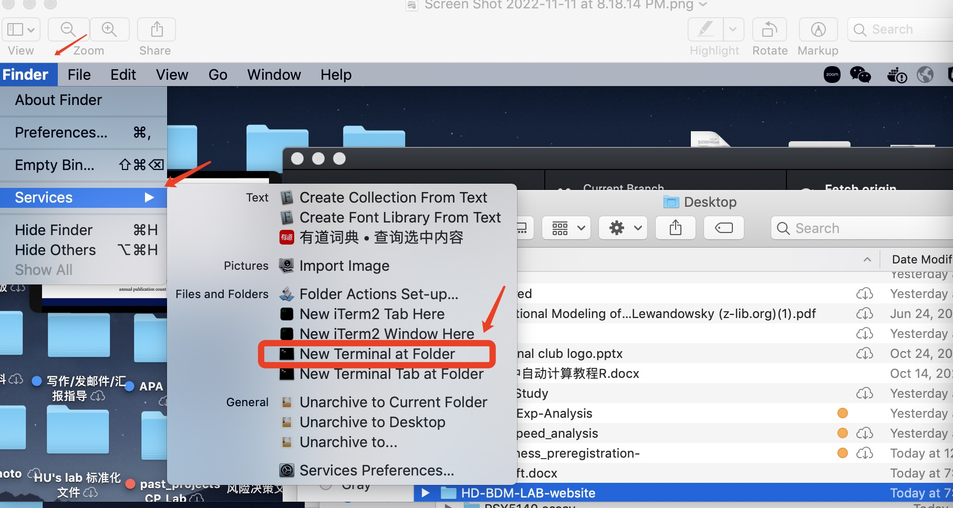
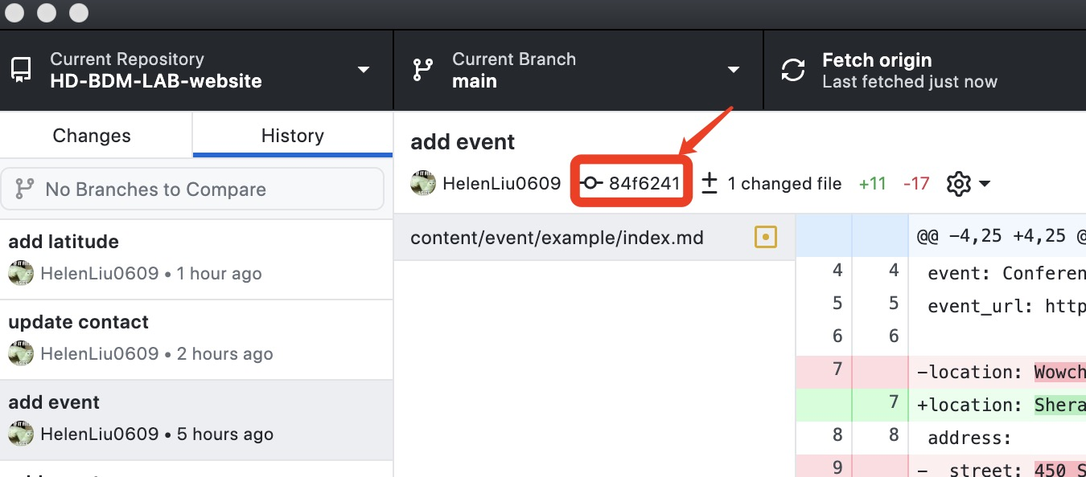
Reverting Repository to a Specific Commit
Sometimes you may want to undo a whole commit with all changes. Instead of going through all the changes manually, you can simply tell git to revert a commit.
Step 1:Open folder terminal
Step 2:. Enter code in terminal
Notes:
git reset --hard
git push -f

